Slide 1

The Writing and Reading Center
Grammar, Editing, and Proofreading Workshop
Bring essays that you are currently working on!

Slide 2
What is proofreading?
Proofreading is the final step in the editing process. It is the examination of a text to identify and fix errors and mistakes in grammar, spelling, and style.

Slide 3
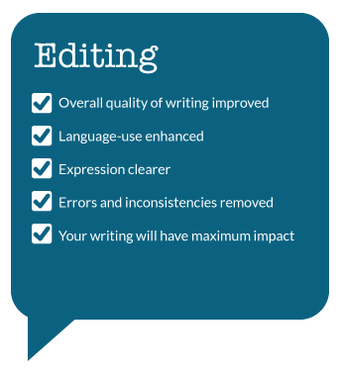
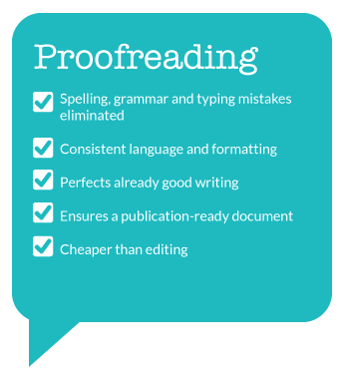
Editing vs. Proofreading

Slide 4
Why is proofreading important?
Proofreading can increase your likelihood to receive an A or even a job. It is important in all forms of writing from emails to resumes. Proofreading ensures that your writing is clear, clean, and precise. Without proofreading it can send the wrong message. Errors that may seem small to you can actually make you appear sloppy and unprofessional to employers, teachers, and others on the receiving end of your work.

Slide 5
Strategies for Proofreading
Do not rely entirely on spelling checkers
Grammar checkers can be even more problematic
Proofread for only one kind of error at a time
Read slow and read every word
Separate the text into individual sentences
Circle every punctuation mark
Read the paper backwards
When in doubt, look it up
Work from a printout, not a computer screen

Slide 6
Things to Look For When Proofreading
Sentence fragments
Subject-verb Agreement
Sentence sprawl (run-on sentences)
Misplaced and dangling modifiers
Faulty parallelism
Unclear pronoun reference
Incorrect pronoun case
Superfluous commas
Apostrophe errors
Words easily confused
Misspellings

Slide 7
What is a Subject?
The subject of a sentence is the person, place, thing, or idea that is doing or being something. You can find the subject of a sentence if you can find the verb.
Ask the question, "Who or what 'verbs' or 'verbed'?" and the answer to that question is the subject.
For instance, in the sentence "The computers in the Learning Center must be replaced."
The verb is "must be replaced." What must be replaced? The computers. So the subject is "computers."
Subject: Sometimes, though, a simple subject can be more than one word, even an entire clause.
Ex. What he had already forgotten about computer repair could fill whole volumes.
Compound Subject:
When a sentence has two or more subjects, that's called a compound subject. The individual subjects are joined by a coordinating conjunction (like and, or, neither, or nor). When the subjects are joined by "and," the verb agrees with the pronoun "they."

Slide 8
What is a verb?
It is a word used to describe an action, state, or occurrence, and forming the main part of the predicate of a sentence, such as hear, become, happen.
What is a predicate?
The predicate of a sentence is the part that modifies the subject in some way. Because the subject is the person, place, or thing that a sentence is about, the predicate must contain a verb explaining what the subject does and can also include a modifier.
A simple predicate is the word that shows the action in a sentence. It is used to tell you what the subject of the sentence does. Ex. She is dancing.
In addition to simple predicates, there are also compound predicates. A compound predicate gives two or more details about the same subject and has two or more verbs joined by a conjunction.
For example: "She visited her cousins and met all their friends."
In this example, "she" is the subject and "visited" and "met" are the predicates joined by "and".

Slide 9
Subject-Verb Agreement
The subject of a sentence is the doer of the action, while the verb represents the action or state of being itself. Both the subject and the verb have to match, whether singular or plural.

Slide 10
Tips:
1. When the subject of a sentence is composed of two or more nouns or pronouns connected by and, use a plural verb.
She and her friends are at the fair.
2. When two or more singular nouns or pronouns are connected by or or nor, use a singular verb.
The book or the pen is in the drawer.
3. When a compound subject contains both a singular and a plural noun or pronoun joined by or or nor, the verb should agree with the part of the subject that is nearer the verb.
The boy or his friends run every day.
His friends or the boy runs every day.

Slide 11
4. Do not be misled by a phrase that comes between the subject and the verb. The verb agrees with the subject, not with a noun or pronoun in the phrase.
One of the boxes is open
The people who listen to that music are few.
The team captain, as well as his players, is anxious.
5. The words each, each one, either, neither, everyone, everybody, anybody, anyone, nobody, somebody, someone, and no one are singular and require a singular verb.
6. Nouns such as civics, mathematics, dollars, measles, and news require singular verbs.
The news is on at six.

Slide 12
Apostrophes
Apostrophes are used with contractions. The apostrophe is always placed at the spot where the letter(s) has been removed. Apostrophes are also used to show possession. Place the apostrophe before the s to show singular possession. Place it after the s to show possession in a plural noun or when the noun ends with s (Ex. Chris, flowers, etc.)
Ex. I left my father’s car in the driveway.
The diplomats’ daughters came with them to the inauguration ceremony.
It’s expressed in the book.
It’s not the muffler shop employees who were responsible for the fraud, but its managers.

Slide 13
Sentence Fragments
Fragments are incomplete sentences. Usually, fragments are pieces of sentences that have become disconnected from the main clause. One of the easiest ways to correct them is to remove the period between the fragment and the main clause. Other kinds of punctuation may be needed for the newly combined sentence.

Slide 14
Examples of Fragments:
Purdue offers many majors in engineering. Such as electrical, chemical, and industrial engineering.
The current city policy on housing is incomplete as it stands. Which is why we believe the proposed amendments should be passed.
I believed her. Despite my doubts about her credibility.
How do you correct a sentence fragment?
1- Attach the fragment to a nearby complete sentence.
2- Revise the fragment by adding whatever is missing – subject, verb, complete thought.
3- Rewrite the fragment or the entire passage that contains the fragment.

Slide 15
Run-ons, Fused Sentences, and Comma Splices
A run-on is (sometimes called a "fused sentence") has at least two parts, both parts of which can stand by itself (in other words, two independent clauses), but the two parts have been fused together instead of being properly connected with the proper punctuation or conjunction.
A comma splice is when you use a comma to join two independent clauses rather than a semi-colon, a conjunction, or a period.
Ex: (Comma Splices and run-ons)
They weren't dangerous criminals, they were detectives in disguise.
I didn't know which job I wanted, I was too confused to decide.
What can you do to break fused sentences? You can use a “comma” followed by “and,” a “semicolon,” or a “period” to break fused, independent clauses.
Ex.
They weren't dangerous criminals; they were detectives in disguise.
I didn't know which job I wanted. I was too confused to decide.

Slide 16
Misplaced and Dangling Modifier
Misplaced and Dangling Modifiers. A misplaced modifier is a word, phrase, or clause that is improperly separated from the word it modifies / describes. Because of the separation, sentences with this error often sound awkward, ridiculous, or confusing.
Ex. Having finished the assignment, the TV was turned on.
1. Name the appropriate or logical doer of the action as the subject of the main clause:
Having arrived late for practice, the team captain needed a written excuse.
2. Change the phrase that dangles into a complete introductory clause by naming the doer of the action in that clause:
Because Maria did not know his name, it was difficult for her to introduce him.
3. Combine the phrase and main clause into one:
To improve his results, he repeated the experiment.

Slide 17
Faulty Parallelism
Parallel structure means using the same pattern of words to show that two or more ideas have the same level of importance. This can happen at the word, phrase, or clause level. The usual way to join parallel structures is with the use of coordinating conjunctions such as "and" or "or.“
Ex. In Florida, where the threat of hurricanes is an annual event, we learned that it is important (1) to become aware of the warning signs, (2) to know what precautions to take, and (3) to decide when to seek shelter.
With the -ing form (gerund) of words: Parallel:
Mary likes hiking, swimming, and bicycling.
With infinitive phrases: Parallel:
Mary likes to hike, to swim, and to ride a bicycle.
Lists After a Colon: Be sure to keep all the elements in a list in the same form singular or plural. Example Parallel:
The dictionary can be used to find these: word meanings, pronunciations, correct spellings, and irregular verbs.

Slide 18
Unclear Pronoun Reference
Unclear Pronoun Reference makes sentences confusing, vague, and difficult to understand. The pronoun usually refer to the noun that comes right before it, but sometimes the sentence is not clearly structured that it is unclear what the pronoun refers to. A pronoun (he, she, it, I , we, you, they, our, your, my, her, his, him, etc) refers to a noun. An antecedent is the noun to which the pronoun refers.
Ex. Larissa worked in a national forest last summer, which may be her career choice.
Correction: Larissa worked in a national forest last summer; forest management may be her career choice.
Ex. Edwin told Kenny that Dr. Wilson suspected that he cheated on the chemistry exam.
Correction: Edwin told Kenny that Dr. Wilson suspected that Edwin cheated on the chemistry exam.

Slide 19
Incorrect Pronoun Case
A pronoun (I, me, he, she, herself, you, it, that, they, each, few, many, who, whoever, whose, someone, everybody, etc.) is a word that takes the place of a noun.
In the sentence Joe saw Jill, and he waved at her, the pronouns he and her take the place of Joe and Jill, respectively. There are three types of pronouns: subject (for example, he); object(him); or possessive (his).
Correct pronoun case requires different forms of personal pronouns for different jobs in sentences: Subjective; Objective; Possessive.

Slide 20
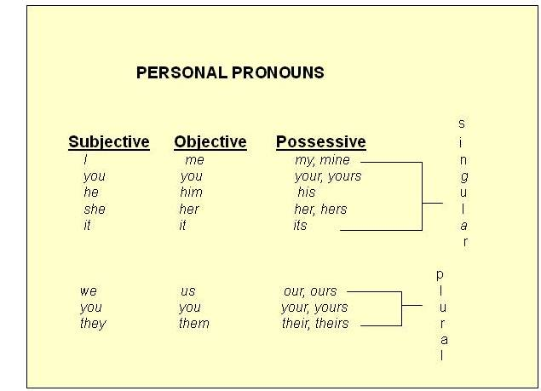

Slide 21
Determine whether the pronoun is being used as a subject, or an object, or a possessive in the sentence, and select the pronoun form to match either as singular or plural:
Castro's communist principles inevitably led to an ideological conflict between he and President Kennedy.
Her and the other dancers carried their own luggage.
Franco bought lottery tickets for they and his cousins.
We had looked forward to the return of the Olympic champion to the games, but we hardly recognized them from across the field.
Both Jill and me are going to Stanford.
The student, as well as his friends, lost their luggage.
Between you and I, this was the most uncomfortable situation ever.

Slide 22
It’s Your Turn To Try...
Identify the mistakes in this document.
with the invention of the personal computer and the Internet, a new age in communications begins. now people could communicate fastest and more easily than ever before. Writing, editing, and storing information became quick and easy. It was no longest necessary to write draft after draft when changes could be made so easily using a word Processor program. Messages, could now be sent in no time to anywhere in the world, without addressing envelopes or licking stamps.
Century most early, around the year 1450 a similar revolution in communications had occurred in Germany. This happened when Johannes Gutenberg invented the printing press. Gutenberg was not the first person to use printing to copy a peace of writing. printing was already being invented in China, where they used clay to print oriental characters. Small items, such as posters and flyers, were already being printed in Europe too, using the woodblock method of printing. Books and other largest works, however, were still being copied by hand. At this time, books were usually produced only in latin, and only the most educated people read them. Gutenbergs' printing press was about to change all of this.

Slide 23
With the invention of the personal computer and the Internet, a new age in communications began. Now people could communicate faster and more easily than ever before. Writing, editing, and storing information became quick and easy. It was no longest necessary to write draft after draft when changes could be made so easily using a word processor program. Messages, could now be sent in no time to anywhere in the world, without addressing envelopes or licking stamps.
Centuries most early, around the year 1450, a similar revolution in communications had occurred in Germany. This happened when Johannes Gutenberg invented the printing press. Gutenberg was not the first person to use printing to copy a piece of writing. Printing was already being invented in China, where they used clay to print oriental characters. Small items, such as posters and flyers, were already being printed in Europe too, using the woodblock method of printing. Books and other largest works, however, were still being copied by hand. At this time, books were usually produced only in Latin, and only the most educated people read them. Gutenberg's printing press was about to change all of this.

