Slide 1

Created by: Professor Kerns, CETL Canvas Ambassador

Slide 2
Quizzes
Canvas Tutorial

Slide 3
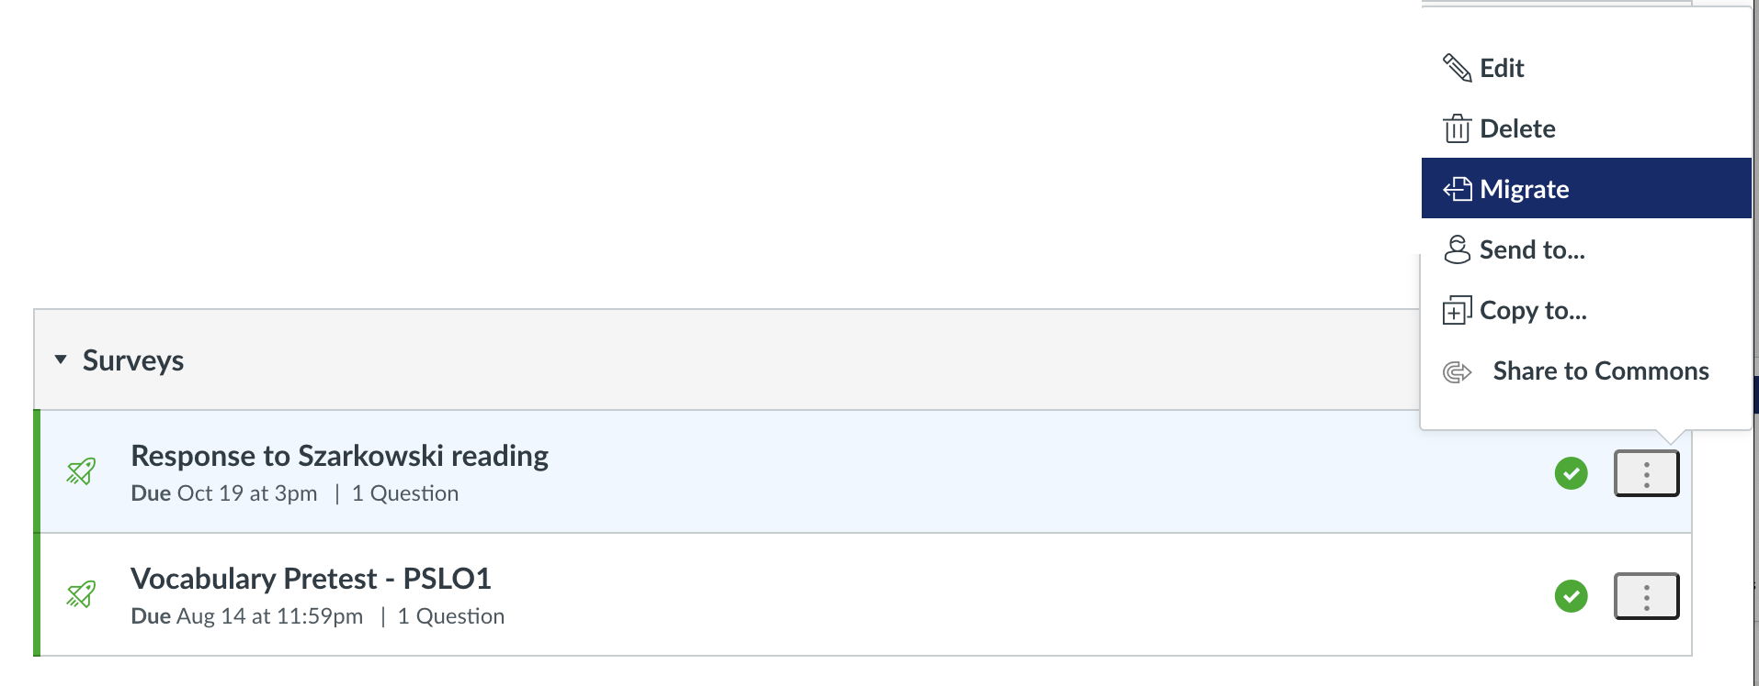
Types of quizzes
Classic Quizzes
  Older formatting
New Quizzes (suggestion option)
  New quizzes has more options and allows you more editability
  You want to use the same option for all your quizzes so you can use the “bank”
  You can migrate your classic quizzes to new quizzes if you need to
In your quizzes section in canvas, you can click
the button and go to migrate. It may take a few minutes to complete.

Slide 4
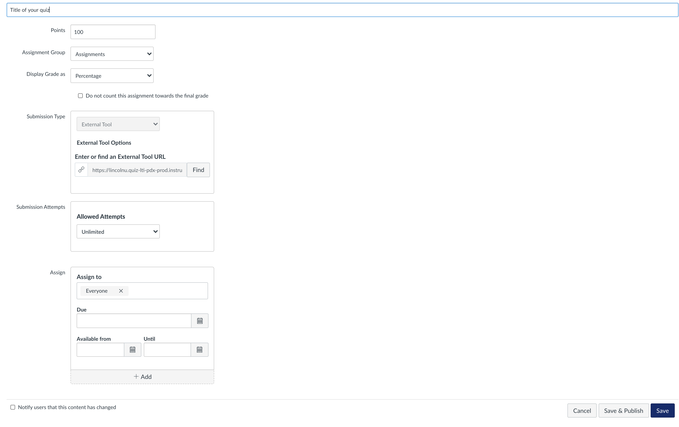
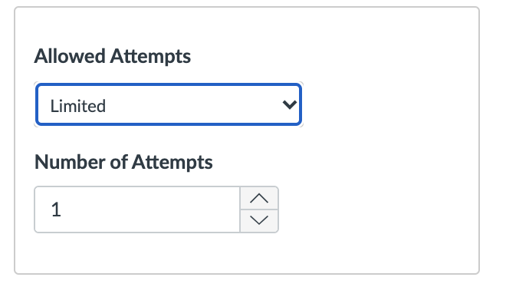

New quiz
Leave this section as the default
Change number of attempts for all students
Change due date for a specific student or group of students

Slide 5
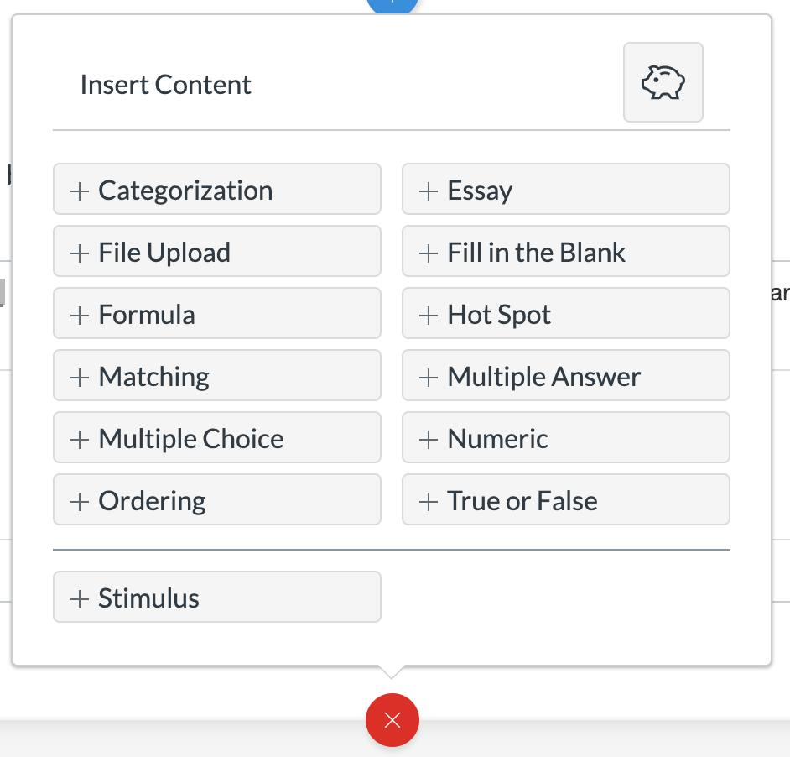
Types of questions

Slide 6
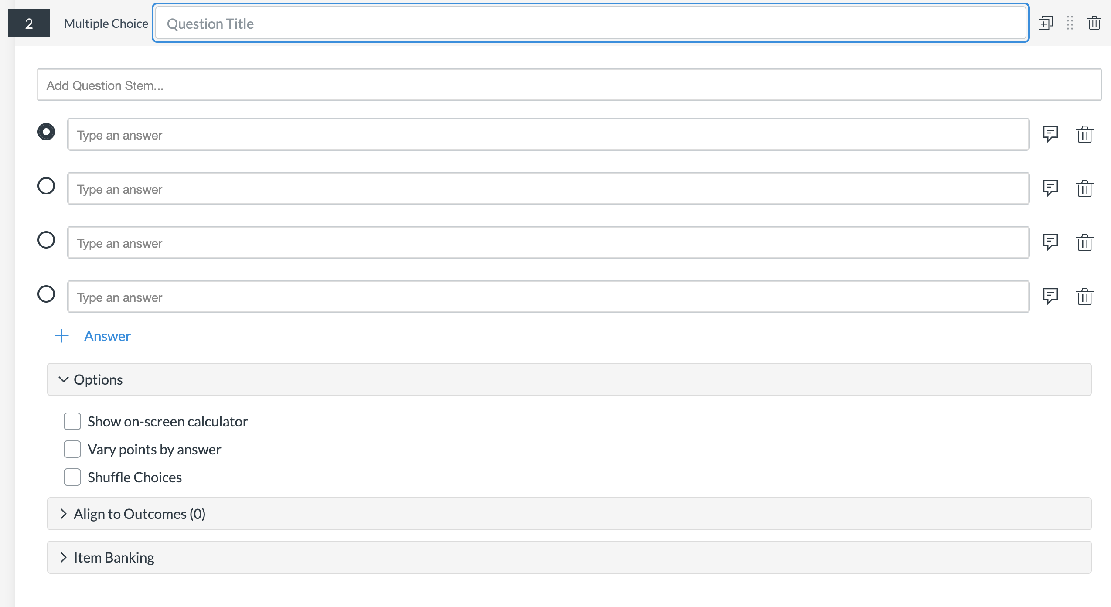

Options
Make sure to title your question so that you can easily
find your question in the “bank”
Write your question here
This is your correct answer

Slide 7
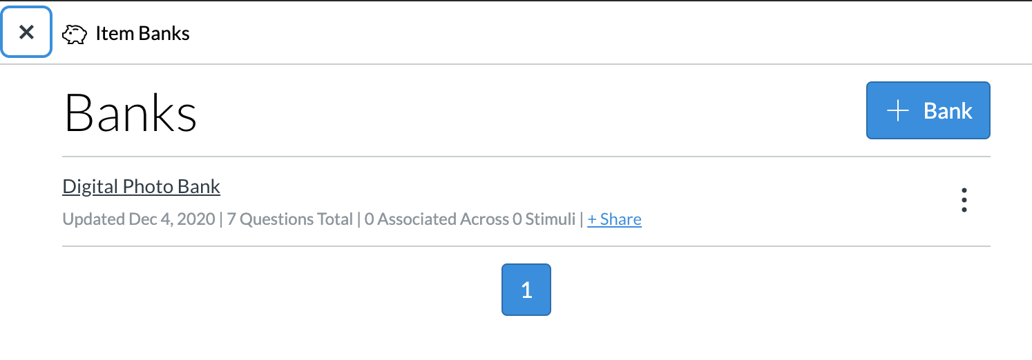
Question bank
Question Banks are a place to house questions that can be added to quizzes across courses or accounts.

Slide 8
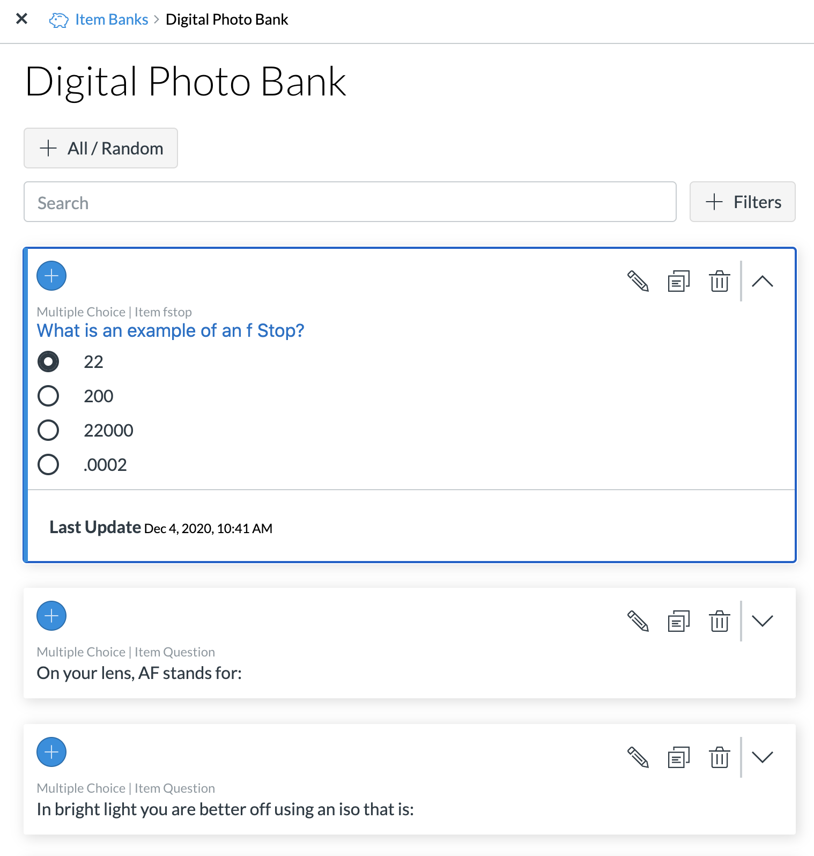
Question bank
here is the title
of your question

Slide 9
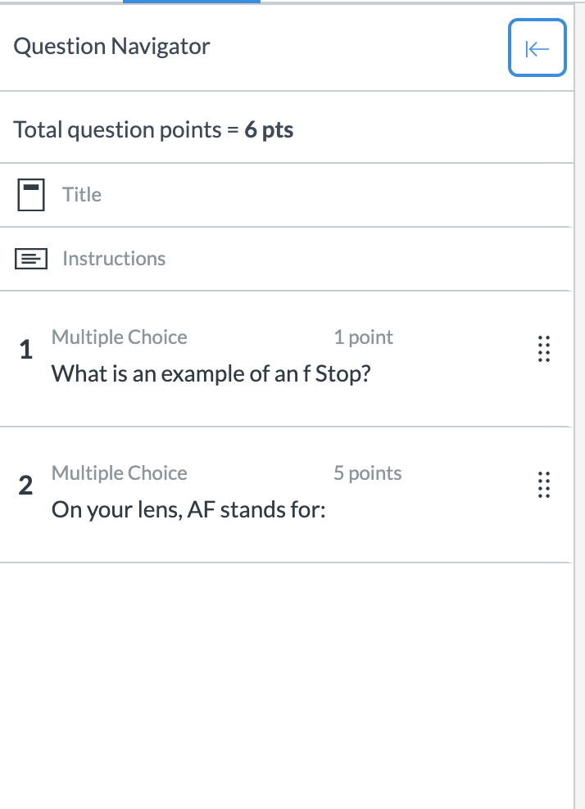
Question navigator
• Quick way to see an overview of your quiz
• Check the point ratings on your questions and the total points for the quiz
• Rearrange your questions with the button

Slide 10
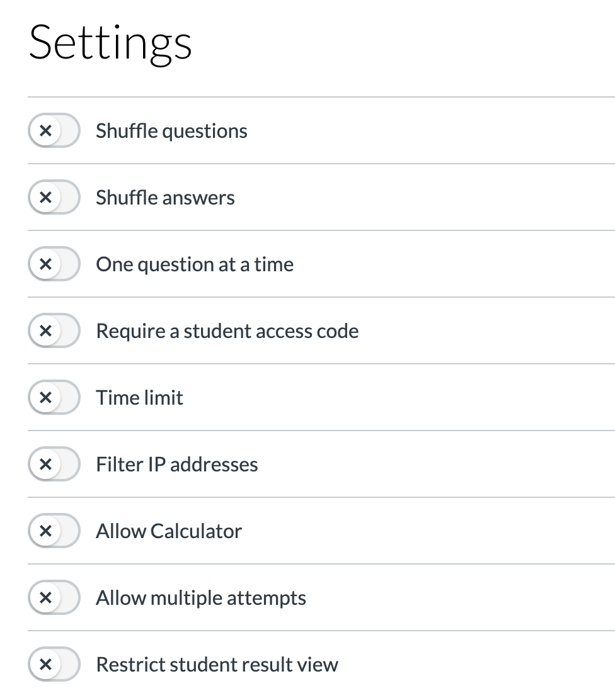
settings

Slide 11
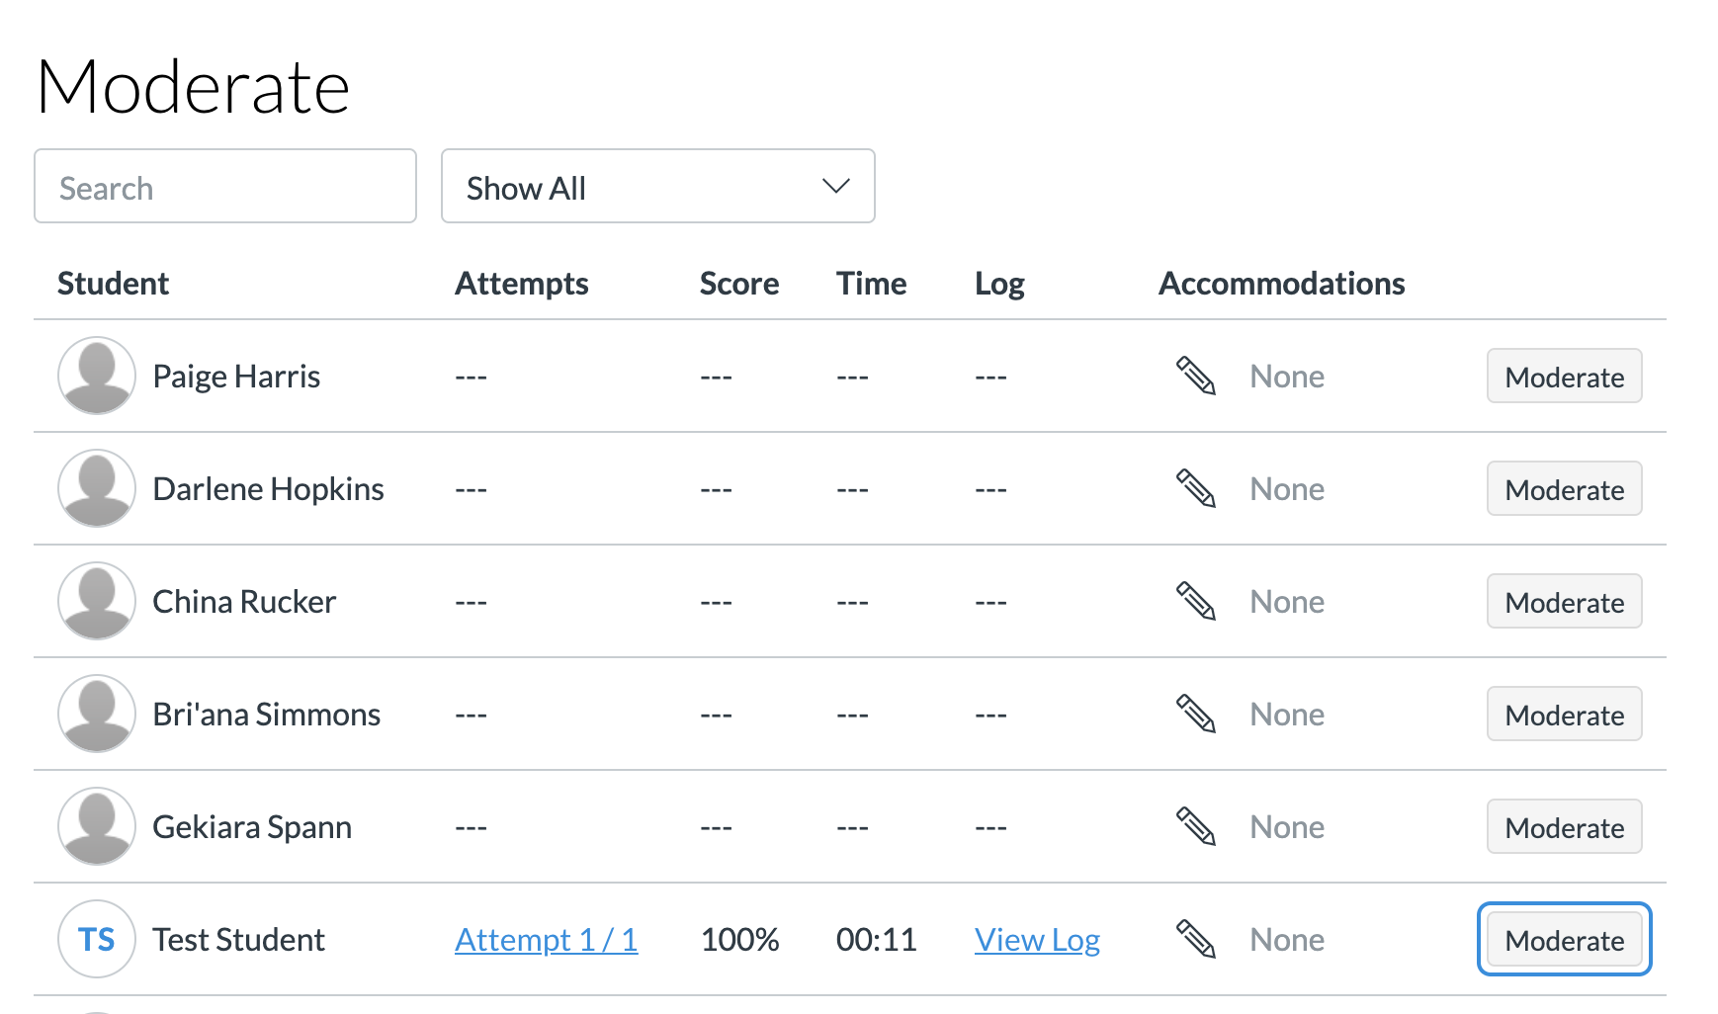
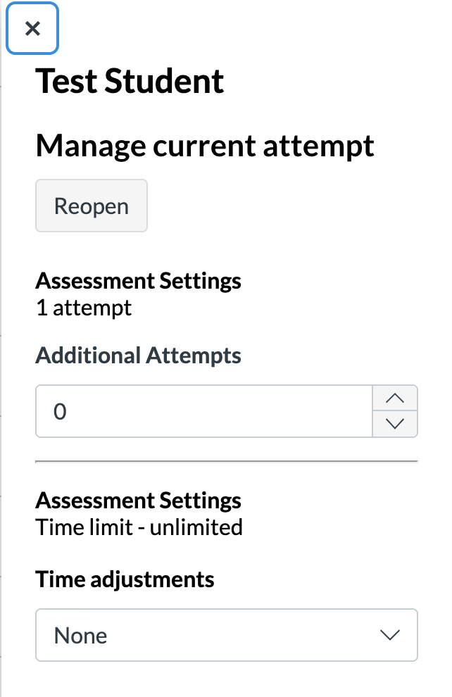
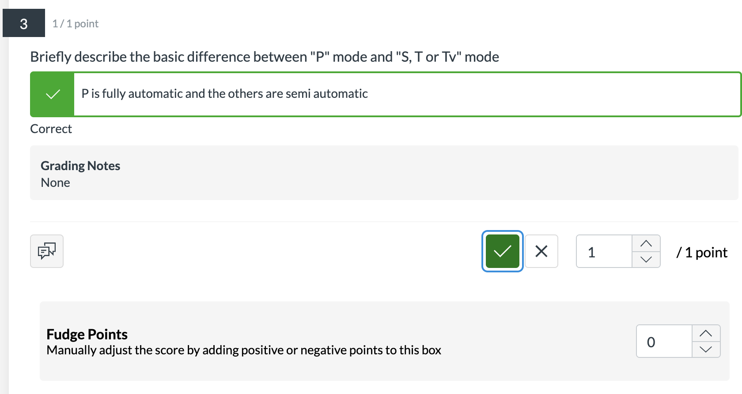
Moderate
Click here to see answers and grade any open-ended questions
Add time or additional attempts for individual students

Slide 12
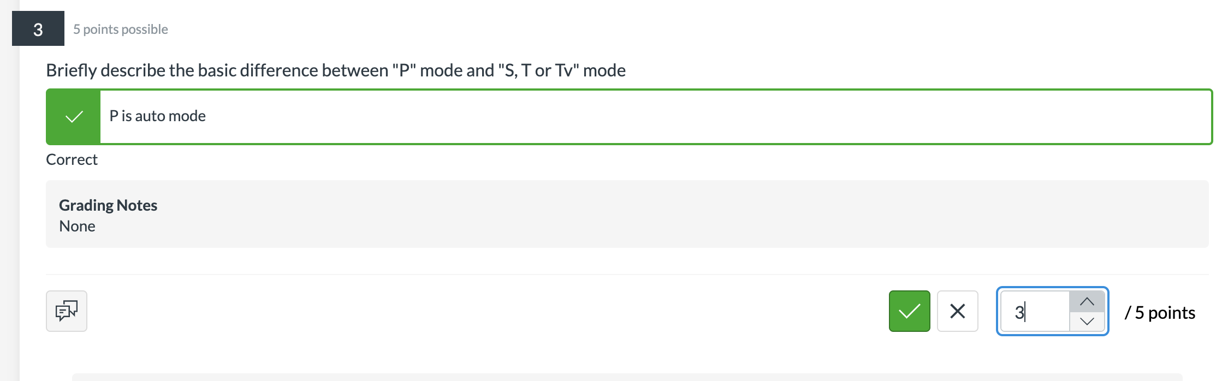

Moderate/ attempt/ grading
When you click attempt, you will be able to grade individual questions
Check for correct
or incorrect
Choose how many
points awarded

